Slide 1

Feedback forum ANALYSIS
Stratify Consulting
MGMT590- AUD
Notes:
Hi everyone, we are stratify consulting
and today we are going to share how we help our client craigslist improve the feedback forum

Slide 2






Meet Our Team
Chaya
Jose
Swati
Jonna
Snow
Amanda
Notes:
This is our team members

Slide 3
AGENDA
Model Design
Model Validation
Conclusion
Problem Statement
Notes:
we are going to go through the background of our project, the problem statement, how we design and validation our model and our conclusion

Slide 4
Problem Statement

Slide 5
Problem Statement
WEBSITE USER
WEBSITE MANAGER
Hard to extract relevant information.
High cost to maintain and organize the website.
Problem Statement
Model Design
Model Validation
Conclusion
Notes:
Craglist is a well-known advertisement website which allow advertisers to post, however the unstructured format is also a problem for both website user as well as manager
it’s hard to extract relevant information for user . While it’s high cost to maintain and organize the website for manager

Slide 6
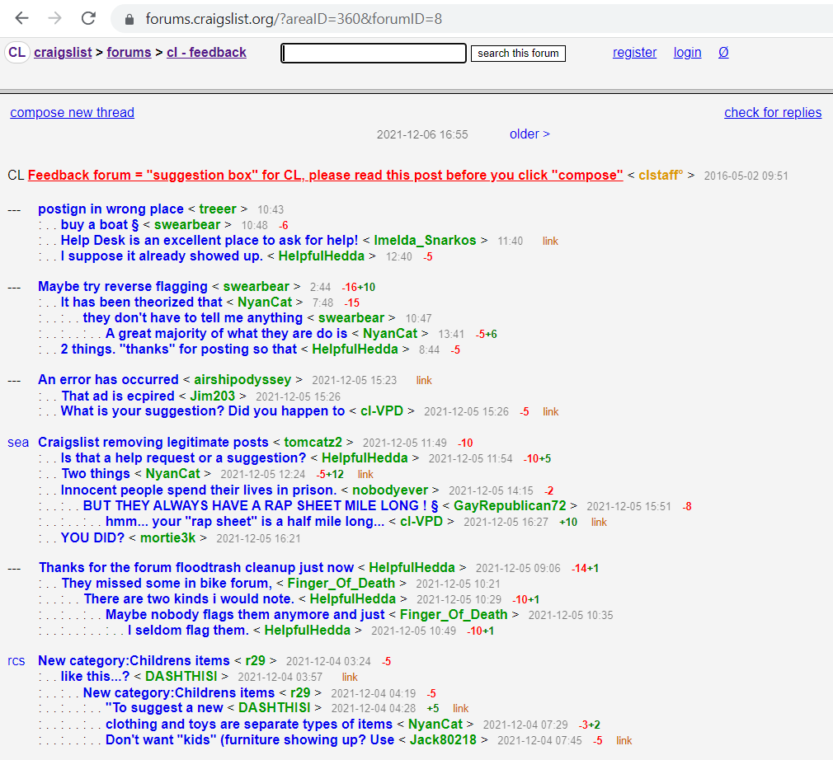
So we decided to start with the Feedback Forum……
Large size of the unorganized posts creates challenges
Can’t efficiently identify and classify major user problems
Jonna
Problem Statement
Model Design
Model Validation
Conclusion
Notes:
So we decide to start with the feedback thinking the best way to improve is from the feedback!
And We actually found out that at the very bottom of the website, there’s a section called feedback.
It allows users to discuss their experiences of using the website and craglist can use the content to improve. And it do have lots of value content.
However, the large size of unorganized comments also exist in feedback section. It’ cant efficiently identify the major user problem

Slide 7
PROJECT OBJECTIVES
Extract data from feedback forum
Utilize the existing categories of the forum to create labels for supervised learning of the model
Design and train the classification model to predict the class of new feedback posts on the forum
Problem Statement
Model Design
Model Validation
Conclusion
Notes:
So our project is aim to help categorize the content in feedback forum and help our clients to effiectlvely improve themself

Slide 8
MODEL DESIGN

Slide 9
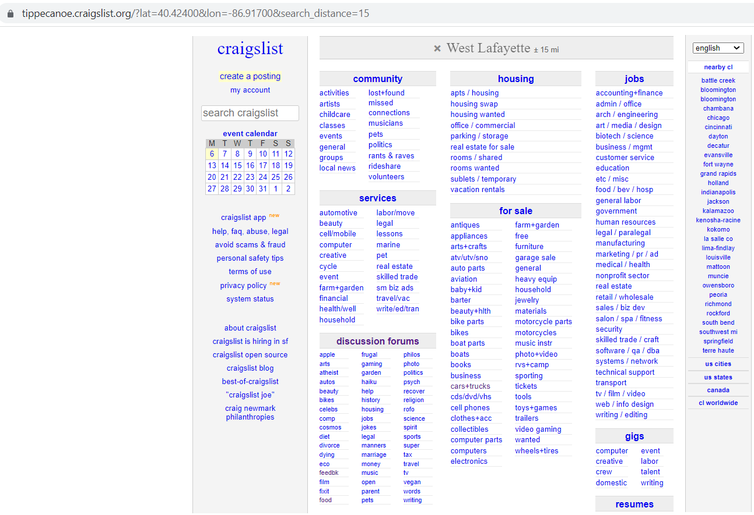
WEB SCRAPING
Feedback Forum
Problem Statement
Model Design
Model Validation
Conclusion

Slide 10
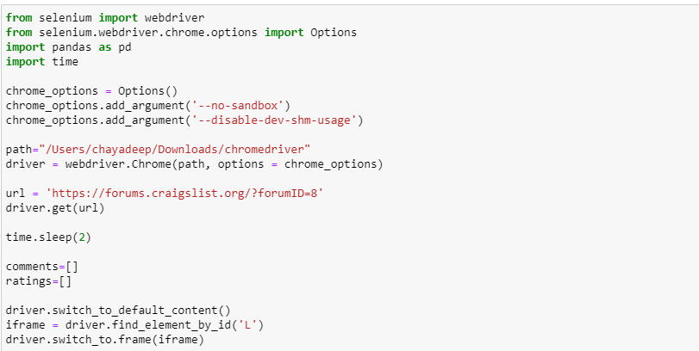
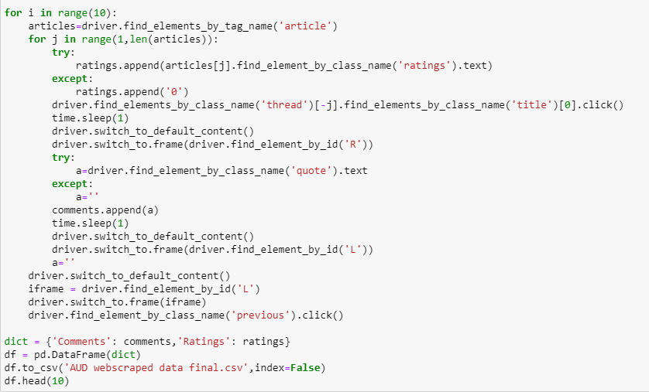
WEB SCRAPING
1
Web
Scraping
Code
2
Problem Statement
Model Design
Model Validation
Conclusion

Slide 11
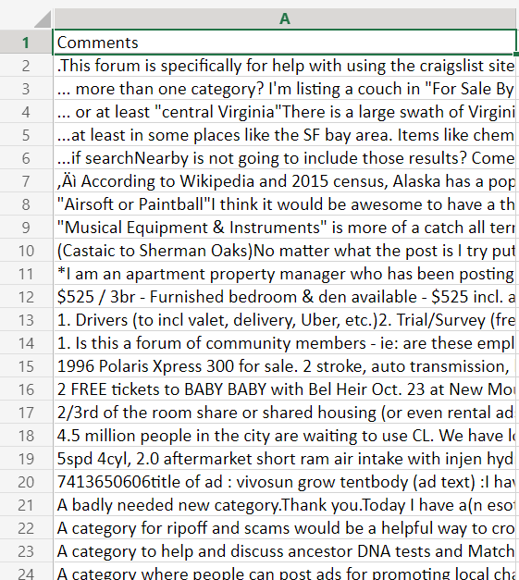

WEB SCRAPING
2355 documents
Problem Statement
Model Design
Model Validation
Conclusion

Slide 12
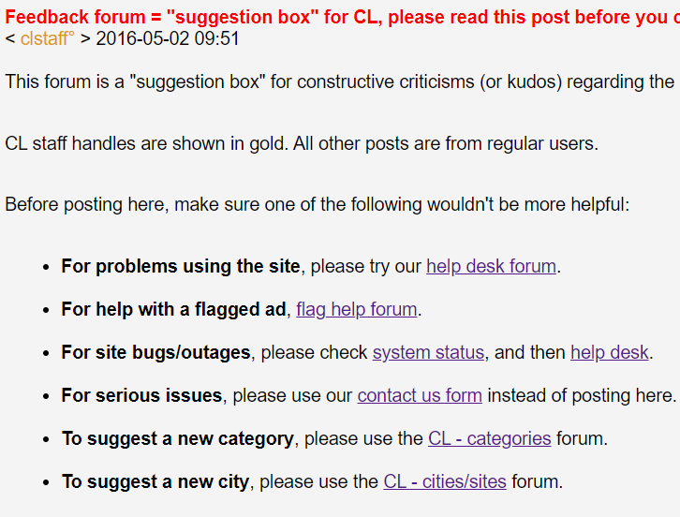
CLASSIFICATION LABEL
Label | Classes | Description
0 | Categories | To create new categories for posts
1 | Cities | To create the category for a new city
2 | Bugs_Outages | To resolve bugs, errors, functionality issues
3 | Flagged | Feedback related to flagging of posts
Problem Statement
Model Design
Model Validation
Conclusion
Notes:
After scrapping the data from the suggestion box on the website, we now have our data with four labels. They are suggestion for adding a categories, suggestion for adding a new city, problems or bugs, and ads flagging.

Slide 13
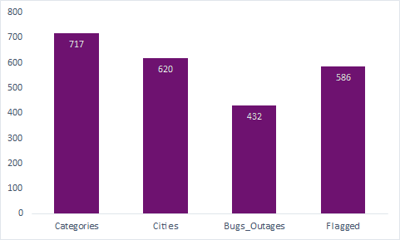
Class Histogram
Notes:
Here is the histogram of our labels. We can find that it is a well classification balanced problem. Therefore, we don't need to do any up sample or down sample on this.

Slide 14
DATA PROCESSING
Tokenization
Lemmatization
Stop Words Removal
Vectorization
Dimension: (2355, 17722)
Problem Statement
Model Design
Model Validation
Conclusion
Notes:
Then, we did the text processing. It include the basic steps of tokenization, lemmatization, stopwords removal, and vectorization.
For the vectorization, we use tfidf vectorization, and set the min_df = 2 to remove potential typo. Besides, we also include 2-gram in order to get more oreder information.
The dimensionality for the entire dataset is 2355 to 17722.

Slide 15
DATA Splitting
80% Training
20% Testing
Problem Statement
Model Design
Model Validation
Conclusion
Notes:
Next, we use the stratify split to split our data, with 80% of training data and 20% of testing data. By using the stratify split, we can make sure that the ratio of each label is the same in both training dataset and testing dataset.
Pass to Snow

Slide 16
MODEL FIT AND TRAINING
Logistic Regression
Stochastic Gradient Descent
Naïve Bayes
Linear Support Vector Classification
Decision Tree
Light Gradient Boosting Machine
Multi-Layer Perceptron Classifier
Problem Statement
Model Design
Model Validation
Conclusion
Notes:
The models we used in process are…
Logistic –is easier to implement, interpret, and easily extend to multiple classes
SGD is also computationally fast
Naïve Bayes - easy to implement; When assumption of independent predictors holds true, a Naive Bayes classifier performs better as compared to other models.
Linear SVC is more effective in high dimensional spaces.
Tree models are very intuitive and easy to present

Slide 17
MODEL VALIDATION
Notes:
So we first run these models individually using cross validation

Slide 18
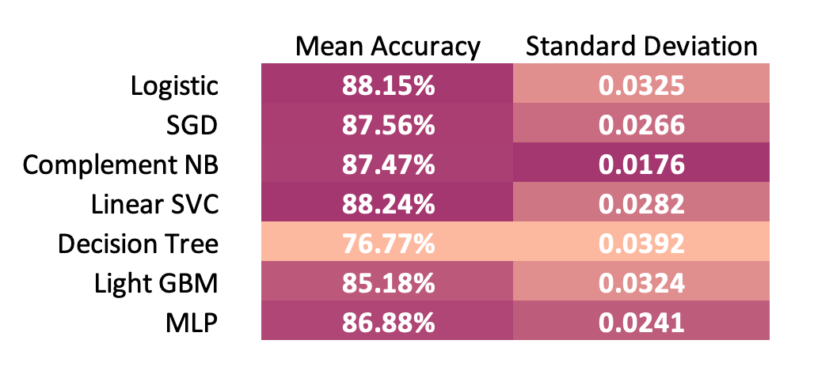
Cross validation
Problem Statement
Model Design
Model Validation
Conclusion
Notes:
These are the results
From perspectives of both accuracy and standard deviation, decision tree performs much lower than the othes.
And the mean accuracies of the other models stay at levels from about 85% to 88%
-------------------
Our next step is to ensemble these models, except decision tree, and to find out the combination that performs the best.

Slide 19
Ensemble
SGD
LSVC
Majority
Voting
Final
Output
Training
Data
LGBM
Testing
Data
Problem Statement
Model Design
Model Validation
Conclusion
Notes:
So our final decision is to conclude SGD, Linear SVC, and Light GBM in our ensemble method and vote for the final output

Slide 20
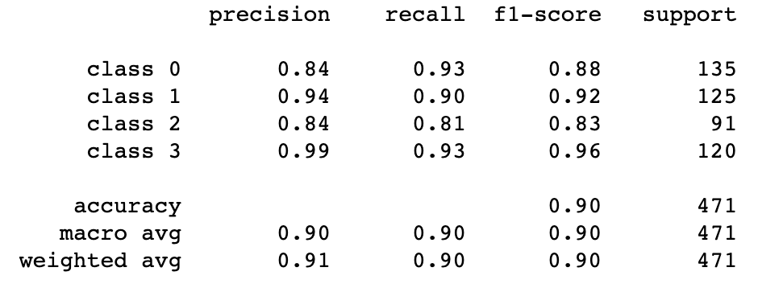
Ensemble
Accuracy 90.23%
Problem Statement
Model Design
Model Validation
Conclusion
Notes:
This method achieves mean accuracy of over 90%
And if we look at the specific results, we can see that the f1-scores for all the 4 classes performed well.
So this is the final model we will recommend to our client.
-------------------
Next, Chaya will show us how our client could apply our model in practice.

Slide 21
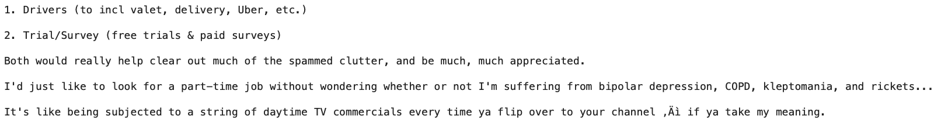
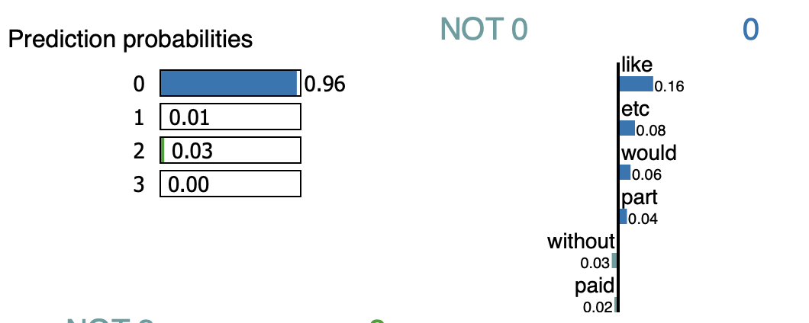
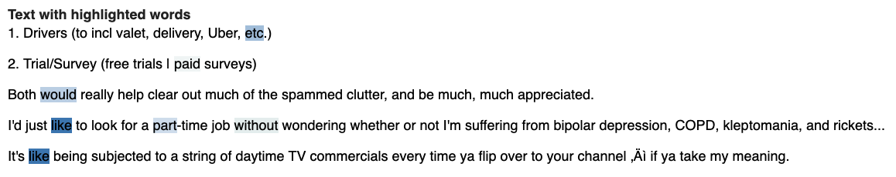
Interpreting predictions
Unseen data
True Label: 0 (Categories)

Slide 22
Topic Modeling
Choosing the number of topics
LDA
Visualizing topics

Slide 23
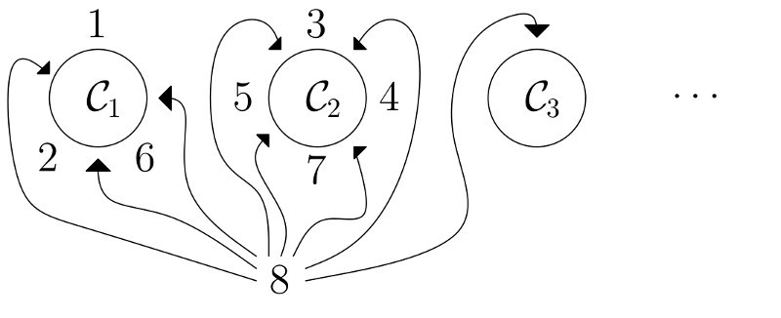
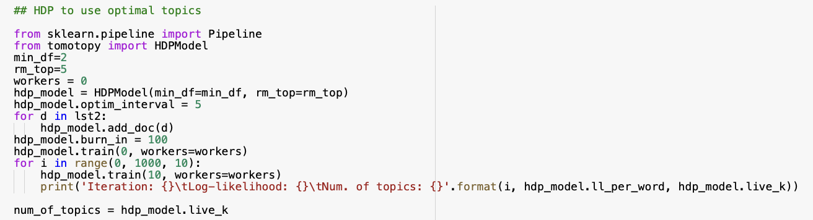
hierarchical Dirichlet process (HDP)

Slide 24
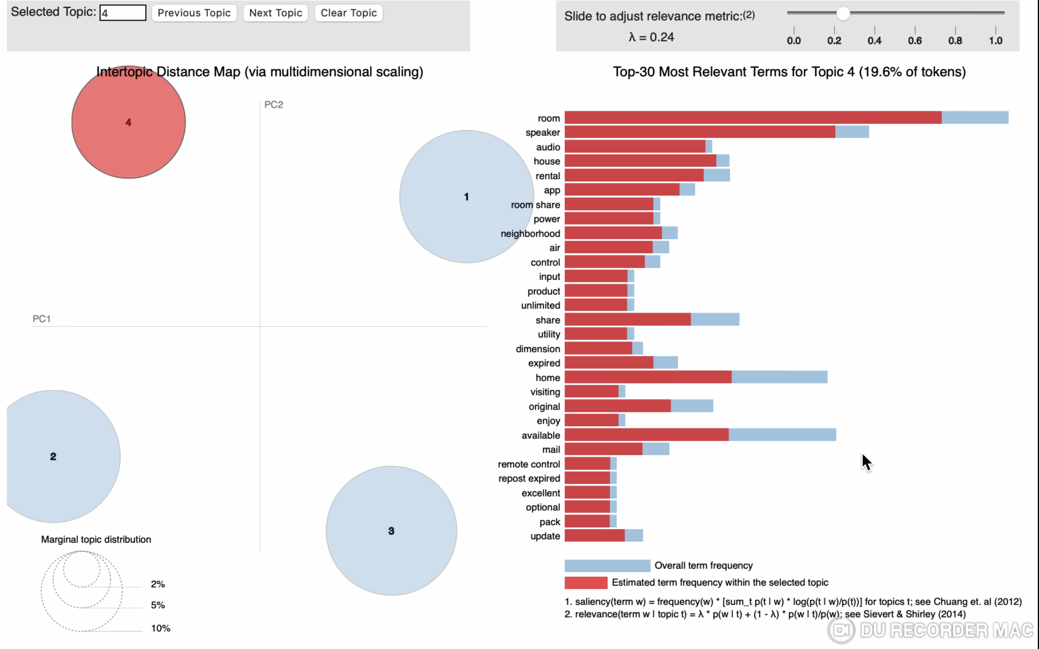
Visualizing LDA topics

Slide 25
CONCLUSION

Slide 26
VALUE ADDITION TO COMPANY
Saves cost : Unclassified feedback
Eliminates manual efforts : Misclassified feedback
Incremental revenue stream: Better insights from feedback
Problem Statement
Model Design
Model Validation
Conclusion

Slide 27
Future Analysis
Sentiment analysis to understand the mood of the users
Net ratings could be utilized to judge the popularity of a feedback
Creating more classification labels for the feedback forum
Model Design
Model Validation
Conclusion
Problem Statement

Slide 28
Thank you

Slide 29
APPENDIX

Slide 30
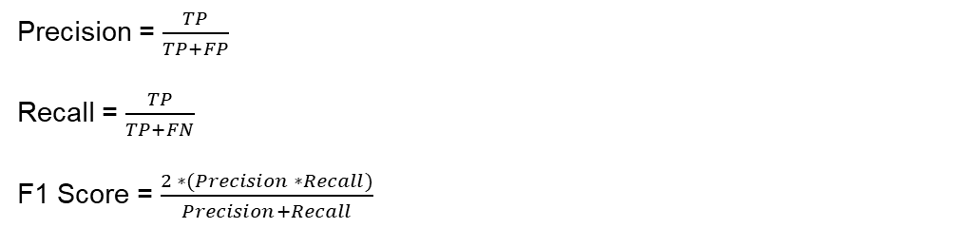
Model evaluation metrics
 | Predicted
Actual | True Positive | False Negative
 | False Positive | True Negative
Precision = $\frac{TP}{TP+FP}$
Recall = $\frac{TP}{TP+FN}$
F1 Score = $\frac{2 ∗(Precision ∗Recall)}{Precision+Recall}$

